Slide 1
ALM 15.0 New Feature Introduction
Chris Paterson
Technical Solutions Consultant

Slide 2
ALM 15 New Features
Autopass
Send Graph by Mail
04
Site Admin REST APIs
03
05
Health Report
03
05
ALM Launcher
Web Runner
02
06
Customer Oriented
Single Sign On
01
New System Requirements
07

Slide 3
Single Sign-on

Slide 4

SSO for On premise
Improved SSO solution
One solution for on-Prem and SaaS
Support for standard IDPs
Support both user interactions and integrations
Support SAML 2.0

Slide 5




Single Sign On
SAML Trust
Identity Provider
(IdP)
Service Provider
(SP)
SAML
OAuth2
Customer
ALM Server

Slide 6


Web Flow SSO
SAML2 token
Access token
User tries to connect to ALM services or resources from browser.
ALM server check the validity of Access token.
Get redirect to SP when Access token is absent or invalid.
Navigate to SP and get redirect to customer IdP (IdP discovery).
User sends IdP credential to customer IdP and pass the authentication.
Retrieve SAML2 token and redirect back to SP.
Navigate back to SP and replace SAML2 token with Access token.
Get redirect back to ALM server.
Navigate to ALM server with a valid Access token.
* All redirections are done by browser.
Customer Intranet/VPN
ALM Server
Customer IdP
Trust
Service Provider
6
5
8
7
4
2
9
ALM Client
3
Services & Resources
1

Slide 7
Web Manual Runner

Slide 8
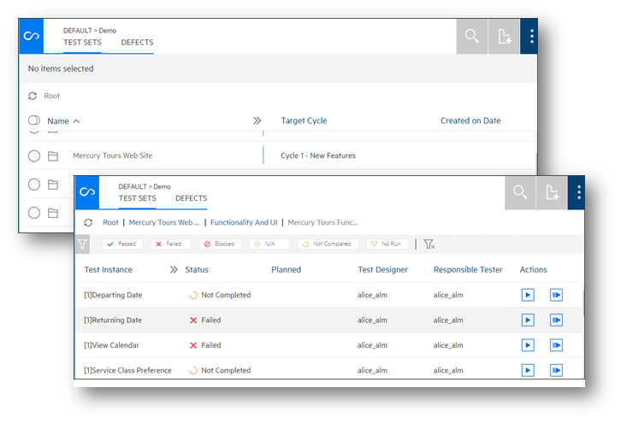
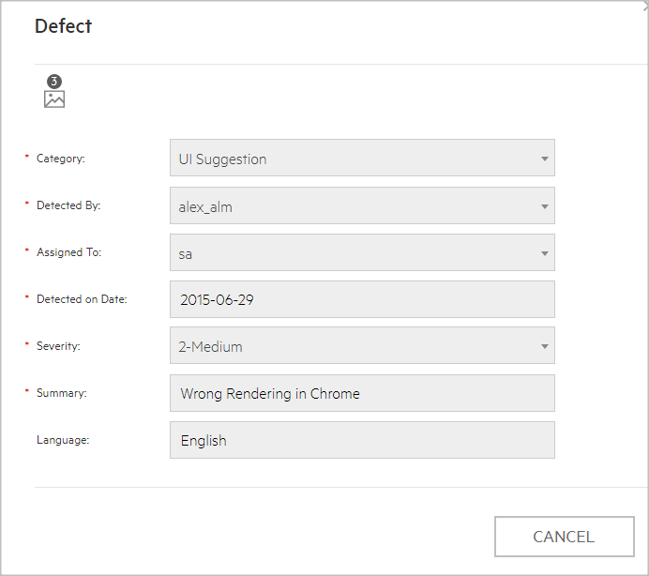
Web Runner
A new web interface that supports manual tests execution and defect reporting.
Pure Web
No workflow
Ability to select tests from ALM and run them in Web Runner
For defects:
When opening a defect mandatory fields will be enforced
No other operations (assign, close etc.) that rely on workflow

Slide 9
Supported Browsers
IE
Chrome
Firefox
Safari

Slide 10
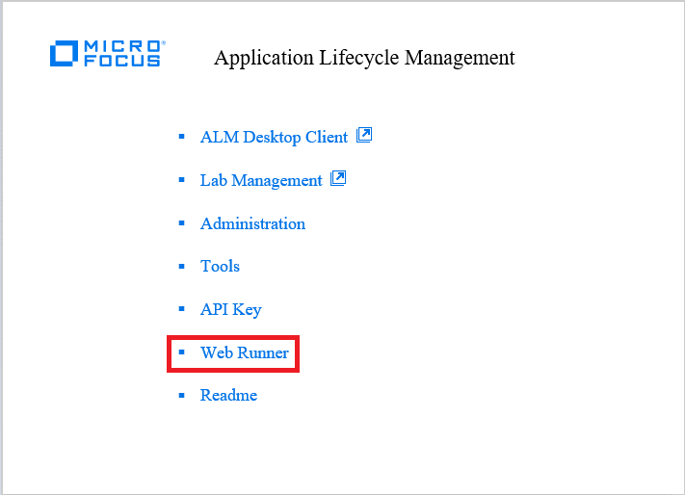
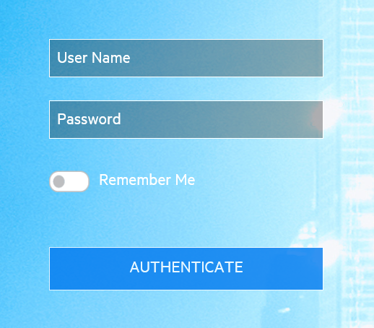
How to Access
From qcbin or navigate by URL http(s)://{server}:{port}/qcbin/webrunner

Slide 11
Admin Role – Define Defect/Run Template
Who is admin? Only TDAdmin role is admin now
Entrance: … >> Entity Settings >> Defect/Run
Add field to template
Remove field from template
Sort field in template
Set field visible/invisible
Set field required/non-required
Set assigned list for a field

Slide 12
Admin Role – Define Defect/Run Template
Set default value for a field
String field
Number field
User field
Single value flat lookup list
Single value tree lookup list
Multiple value flat lookup list
Multiple value tree lookup list
Memo field

Slide 13
Admin Role – Define Defect/Run Template
Rules:
Fields required in metadata is showing in template by default
Fields required in metadata cannot be set to non-required
Required field without default value cannot be set to invisible
Cannot change assigned list for verify value field
Cannot type value in editor for verify value field

Slide 14
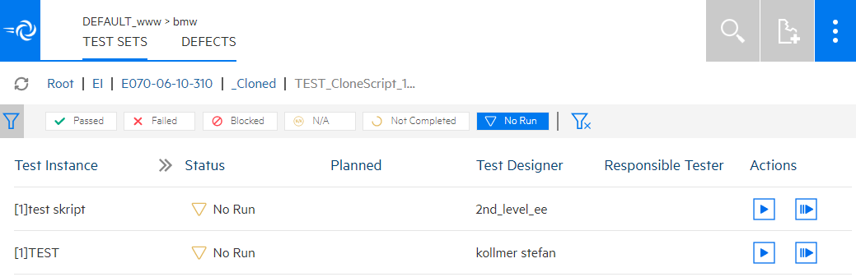
User Role – Navigation, filter and execute
Click test set folder/test set or breadcrumbs to do navigation
In test instances, click on status in filter pane to do filter
Only system defined status can be filtered
Click buttons beside test instance to start/continue run

Slide 15
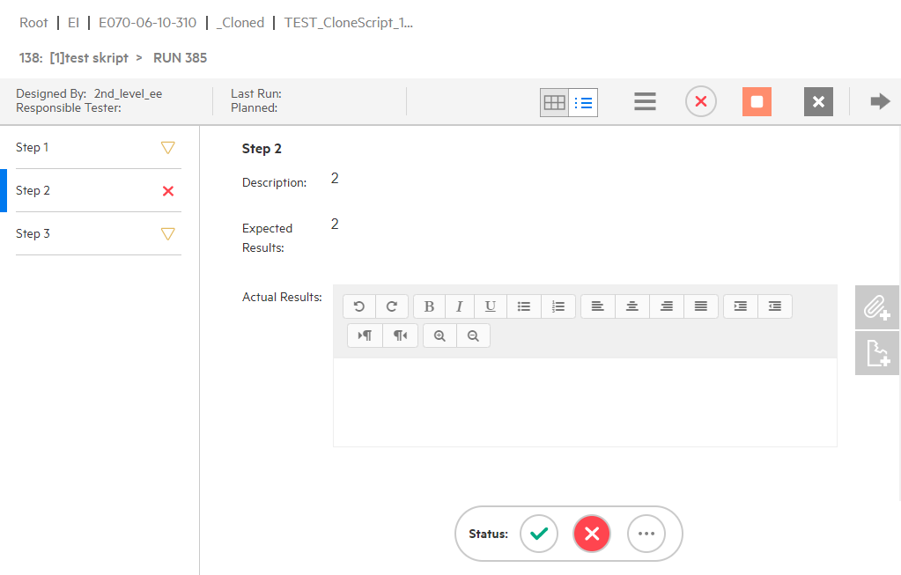
User Role – Execution Details View
Select step
Input actual result
Mark step status
Quick mark status
Mark status for run
Add attachment for run step
Add defect for run step
Add defect for run
Linked existed defect for run
Stop run
Cancel run
Run next/previous test

Slide 16
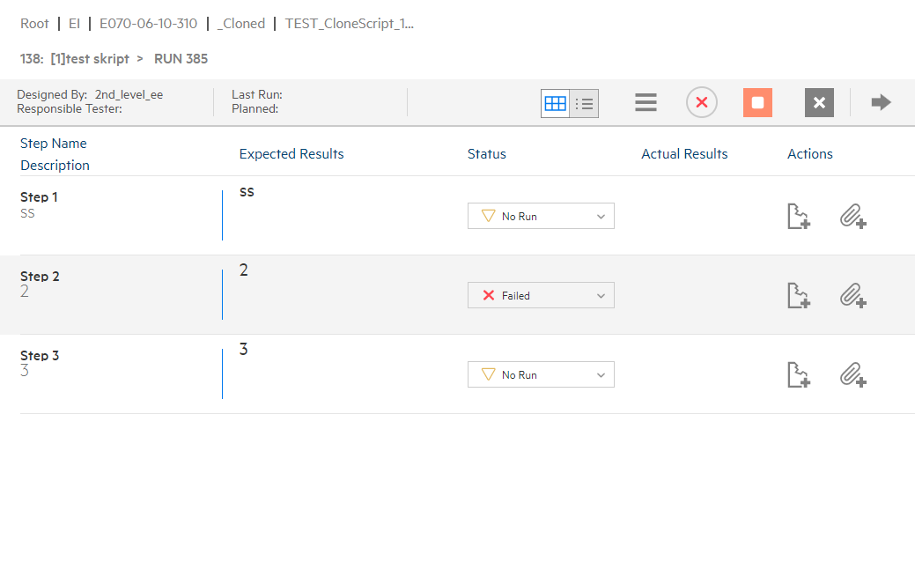
User Role – Execution Grid View
Select step
Input actual result
Mark step status
Mark status for run
Add attachment for step
Add defect for run step
Add defect for run
Linked existed defect for run
Stop run
Cancel run
Run next/previous test

Slide 17
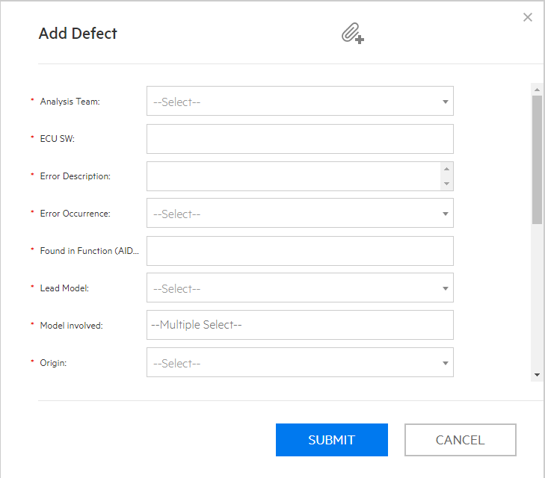
User Role – Create defect
Create defect without linkage
Create defect linked with run
Create defect linked with run step
Add attachment to defect

Slide 18
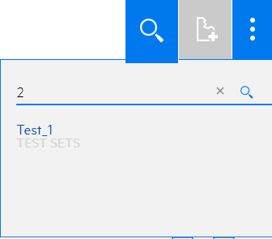
User Role – Search and go to a test set
Search a test set by its ID
Go to test set by clicking result

Slide 19
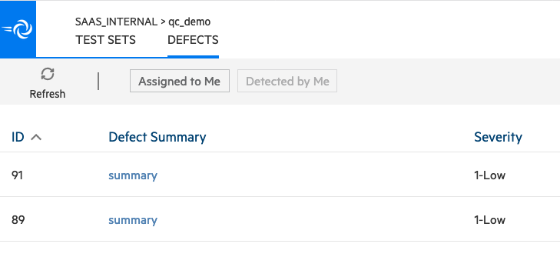
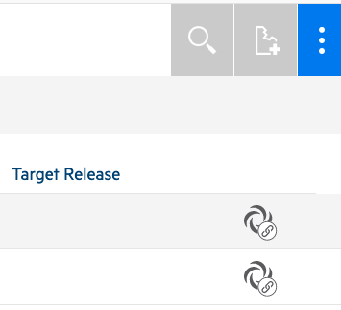
User Role – Defect Module
View defects assigned to me
View defects detected by me
View only, cannot edit for now

Slide 20
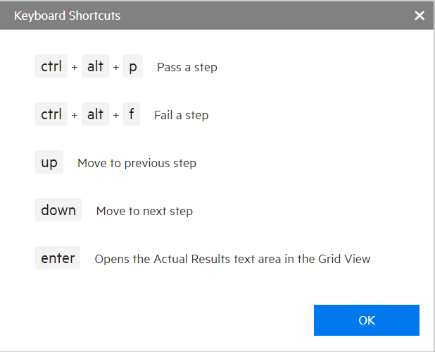
User Role – Shortcuts

Slide 21
Online Help Document
https://admhelp.microfocus.com/alm/en/15.00/online_help/almhelp_CSH.htm#140000

Slide 22
Health Report

Slide 23
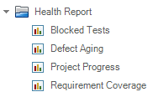

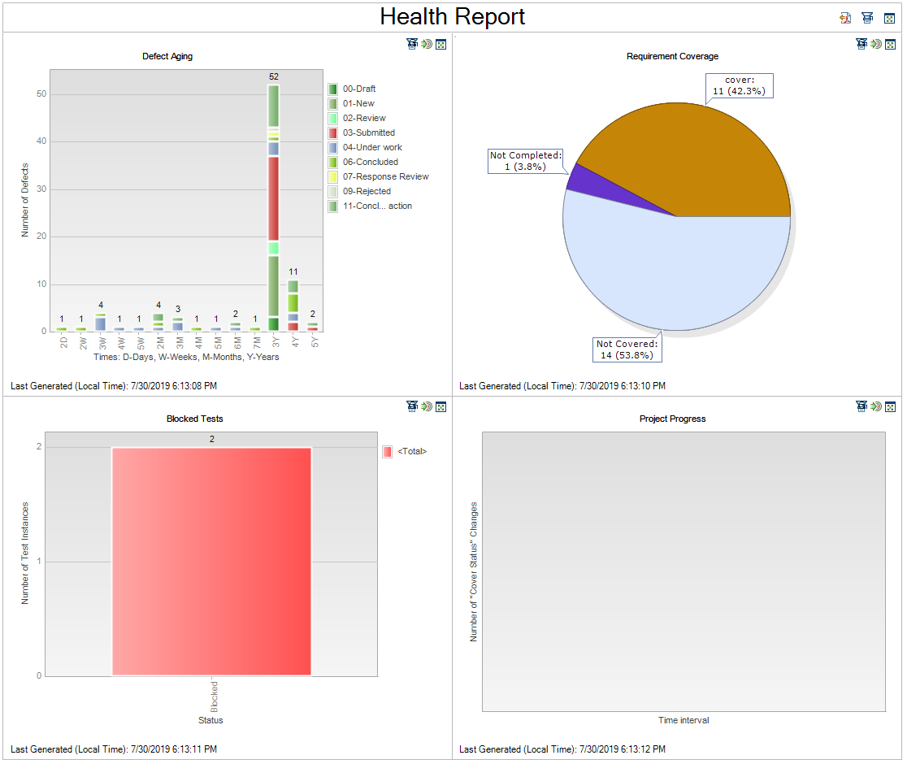
Analysis and Dashboard Module
A “Health Report” folder with 4 default health reports will be created in Analysis module
A dashboard item called “Health Report” will be created in Dashboard module
Health report is always on top
Multiple health reports can be added

Slide 24
Overview
Blocked Tests
Shows a test summary of blocked test instances in an ALM project
Defects Aging
Shows the lifetime of defects in an ALM project. The lifetime of a defect begins when it is reported, and ends when it is closed.
Project Progress
Shows the history of changes to requirements in an ALM project, for each time interval displayed
Requirements Coverage
Shows how many requirements are currently in an ALM project, according to their test coverage status

Slide 25
Send Graph by Mail

Slide 26
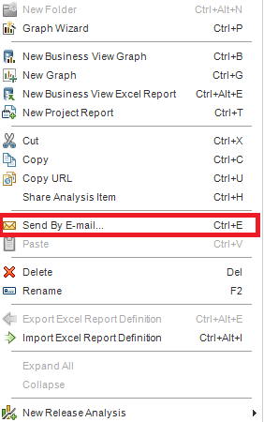
Overview
Now in ALM, a graph can be sent by email.
Select a graph, right click to open menu and select “Send By E-mail” to send a mail of the graph.
You can also send the mail by OTA API(Load concern)
AnalysisItem.Mail To, CC, 0, Subject, Comment

Slide 27
AutoPass License Server

Slide 28
Overview (Technical preview)
AutoPass license server setup
Integrate ALM with APLS
Get license for APLS
Manage APLS

Slide 29
AutoPass license server setup
AutoPass license server 10.9.2 will start to integrate with ALM 15.0x
AutoPass installation guide: (Wait for official release guides)

Slide 30
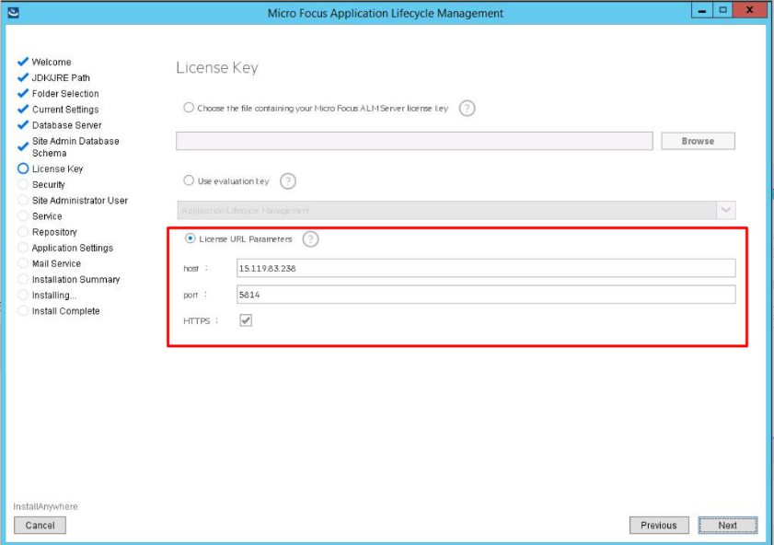
Integrate ALM with APLS
During ALM installation, in License Key section:
Select License URL Parameters
Input APLS information

Slide 31
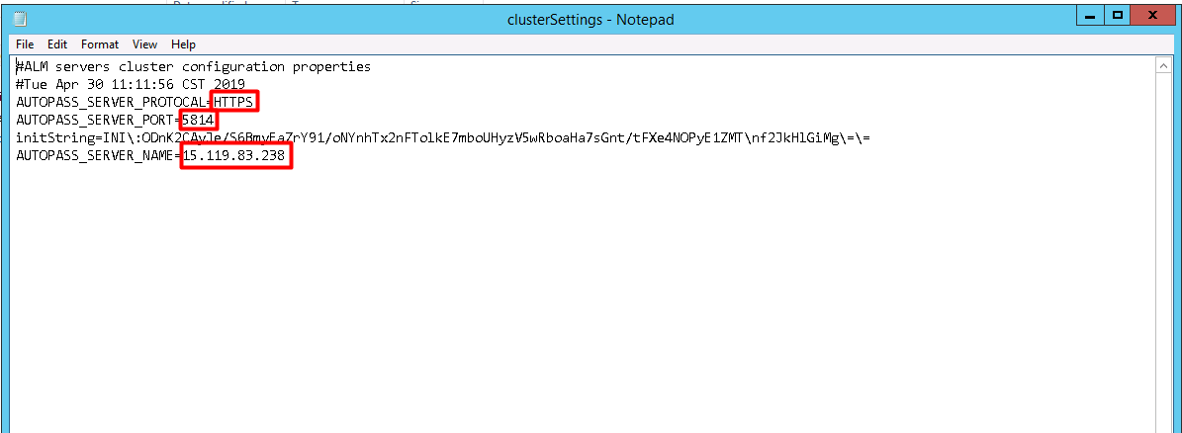
Integrate ALM with APLS(Rare case)
For an installed ALM server:
Go to {deployment path}\repository\sa\Admin\MaintenanceData\conf
Edit parameters in clusterSettings.properties as highlighted
Restart ALM server

Slide 32
AutoPass Integration & License pool
Integration with AutoPass license server.
Licenses can be assigned to pools.
Multiple domains can be assigned to a license pool.
Domains and projects in a same pool share licenses.
Project
Domain
License Pools

Slide 33
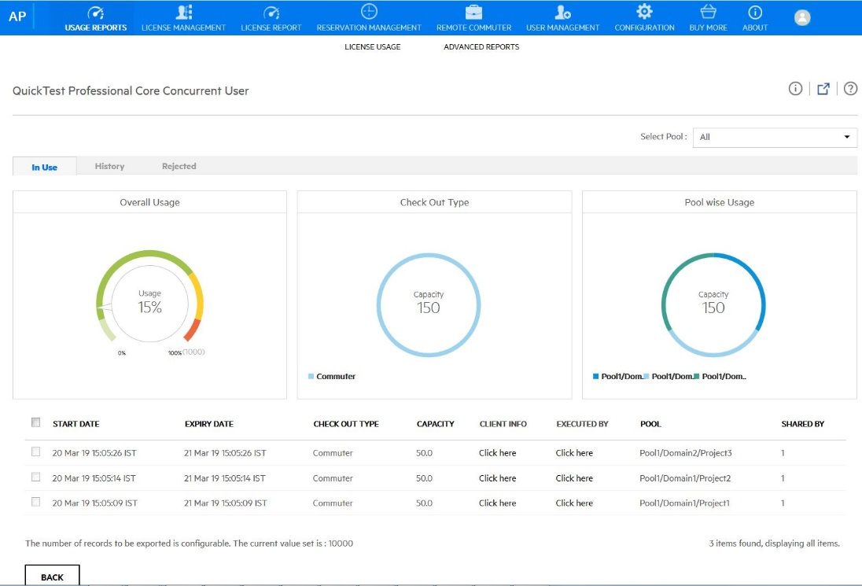
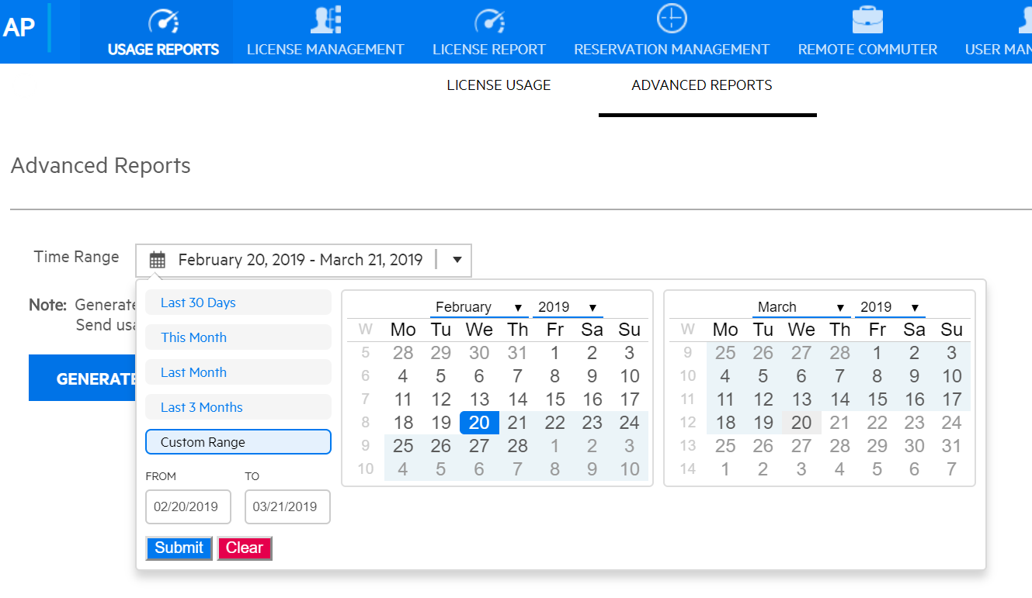
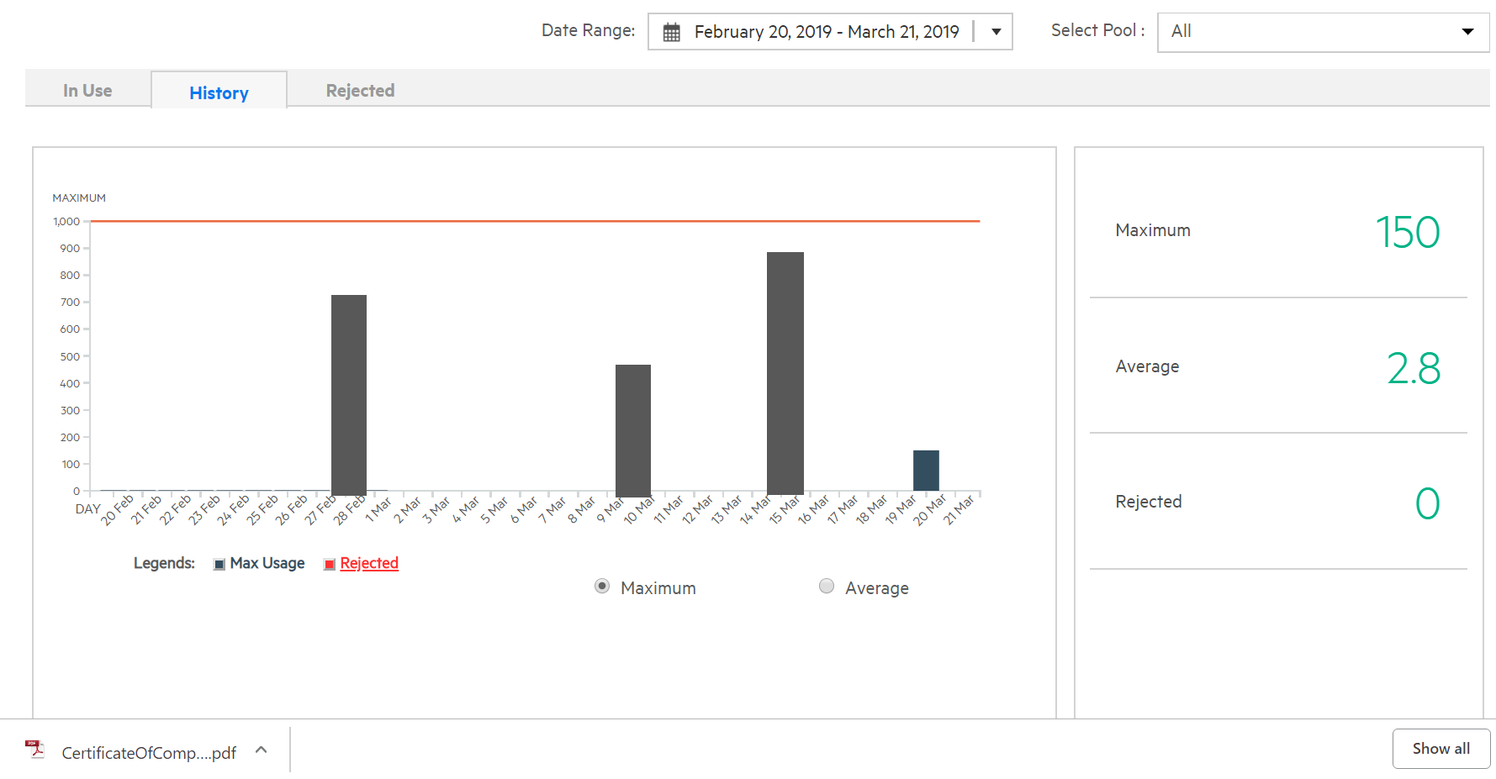
APLS Usage graphs and MSP Reports
For MSPs to generate periodic reports to be sent for billing purpose
Graph showing usage over a period of time

Slide 34
Site Admin REST API

Slide 35
Content
Site Admin Authentication
Domains
Projects
Site Users
Projects Users
Project Extensions
Site Extensions
Site parameters

Slide 36
Site Admin REST APIs
Category | HTTP | URL
User | POST | /site-users | User createUser(User user)
 | GET | /site-users | Users getAllUsers()
 | GET | /site-users/{user} | User getUser(String userName)
 | PUT | /site-users/{user} | User updateUser(String userName, User user)
 | DELETE | /site-users/{user} | String deleteUser(String userName)
 | PUT | /site-users/{user}/active | User activeUser(String userName)
 | PUT | /site-users/{user}/deactive | User deactiveUser(String userName)
 | GET | /site-users/{user}/projects | Projects getUserProjects(String userName)
Project Users | POST | domains/{domain}/projects/{project}/users | Void addNonAdminUserToProject(String domain, String project,User user)
 | GET | domains/{domain}/projects/{project}/users | Users getAllUsersInProject(String domain,String project)
 | DELETE | domains/{domain}/projects/{project}/users | void removeUserFromProject(String domain, String project, User user)
Project | POST | /domains/{domain}/projects | Project createProject(String domain, Project project)
 | GET | /domains/{domain}/projects | Projects getAllProjects(String domain)
 | GET | /domains/{domain}/projects/{project} | Projects getProject(String domain, String project)
 | DELETE | /domains/{domain}/projects/{project} | String deleteProject(String domain, String project)
 | DELETE | /domains/{domain}/projects/{project}/remove | String removeProject(String domain, String project)
 | PUT | /domains/{domain}/projects/{project}/active | Project activeProject(String domain, String project)
 | PUT | /domains/{domain}/projects/{project}/deactive | Project deactiveProject(String domain, String project)
 | POST | /domains/{domain}/projectsrestore | Project restoreProject(String domain, Project project
 | GET | /domains/{domain}/projects/import | Project importProjectFromMultipartData(InMultiPart inMultiPart)
 | GET | /domains/{domain}/projects/{project}/export | StreamingOutgoingObject exportProject(String domain, String project)
Project Maintenance | POST | /projects/{project}/maintenance/tasks/ | void verifyProject(String domain, String project)
 | GET | /projects/{project}/maintenance/tasks/ | String readTaskStatus(String domain, String project)
Project Extensions | POST | /projects/{project}/extensions | enableExtensionsForProject(String domain, String project, Extensions extensions)
 | GET | /projects/{project}/extensions | getEnabledExtensionsForProject(String domain, String project)
Extensions | GET | /extensions | getExtensions(String domain, String project)
Site Parameter | GET | /site-params | SiteParams getAllParams()
 | GET | /site-params/{param} | String getParamValue(String paramName)
 | PUT | /site-params | SiteParam setParamValue(SiteParam param)
 | DELETE | /site-params/{param} | String removeParam( String paramName)
 | POST | /site-params | SiteParam createParamValue(SiteParam param)

Slide 37
Online Help Document
https://admhelp.microfocus.com/alm/en/15.00/SA_REST_API/Default.htm

Slide 38
ALM Client Launcher

Slide 39
Overview
ALM Client Launcher is a lightweight, portable, and flexible tool that enables you to run an ALM client on any Windows machine without the need of downloading it from an ALM server and without Windows administrator permissions.
As an administrator you can package and store the ALM client on USB devices, local or remote storage, shared folders, etc.
Launcher itself without ALM client files cannot work with ALM.

Slide 40
Best Practice
Admin downloads ALM client
Put ALM launcher inside the client files
Delete *.cab inside the client files(The step is optional to make size smaller)
Write a bat file with below command, save to same level as the ALM client folder
“{ALM client folder name}\ALMClientLauncher.exe" -url=http(s)://{ALM server}:{port}/qcbin
Zip the client folder along with the bat file
Put the file to {Deployment path}\webapps\qcbin\Apps
Edit index.jsp under {Deployment path}\webapps\qcbin\, add a line to list section
<li><a href="./Apps/{Zipped file name}" title=“{Tooltip for the link}">ALM Client Package With Launcher</a>
Normal user download ALM client with launcher from qcbin
Unzip the file and run the bat file

Slide 41
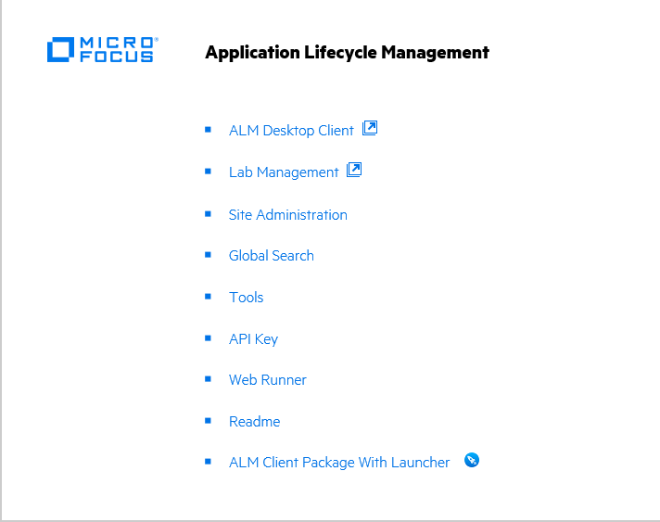
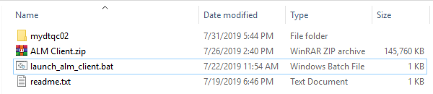
Best Practice

Slide 42
Benefits
Users do not need to install ALM Platform Loader
All client files are zipped so that the download time cost will be reduced
Users can download using any browser
Users do not need to know the ALM server URL
Admin can distribute the ALM client (with launcher) in different ways
Run ALM client independently without IE browser
No need to add URL to IE Trusted Sites! (a SaaS issue)

Slide 43
What else can the Launcher do?
Launch lab management
Open entity link by ALM client launcher
Register ALM client for current user
ALMClientLauncher.exe -reg or ALMClientLauncher.exe –r
Unregister ALM client for current user
ALMClientLauncher.exe – unreg

Slide 44
How to get
Available on marketplace
https://marketplace.microfocus.com/appdelivery/content/alm-client-launcher
Online help document
https://admhelp.microfocus.com/alm/ALM_Client_Launcher/ALM_Client_Launcher_Guide.pdf

Slide 45
ALM 15 Others

Slide 46
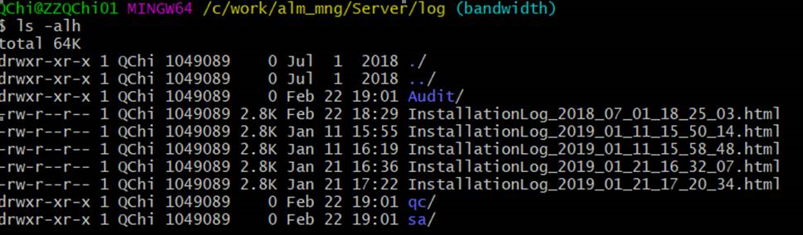
[QCCR1J100858] Need Audit Log - Updated to include additional info for GIS Audit Requirement
Introduced from ALM 12.55 P4
Set site parameter ENABLE_AUDIT = Y to enable audit ALM sessions
Add more informative content and critical events, e.g. login session, connected project. It will be easier to map the audit log with sessions history in database for audit purpose.

Slide 47
QCCR1J101498: Client Certificate option to be added to REST based Upload Excel Addin
Introduced from ALM 12.60 P2
Locate ExcelAddIn.dll.config under C:\Program Files (x86)\Micro Focus\Addins
Edit it and change highlighted value to “Y”
<add key="CLIENT_CERTIFICATE_REQUIRED" value="Y"/>
During authentication in Excel Upload Addin, a popup for selecting certificate will be displayed.

Slide 48
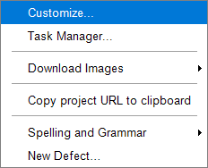
QCCR1J87528: How to disable the clear history permanently on site admin level
Site parameter : DISABLE_CLEARHISTORY
When the parameter equals “Y”, the clear history menu item in ALM client will be invisible.

Slide 49
QCCR1J100008: Separate LOG Option for ALI Extension (VW)
Put attached file in repository folder: {ALM repository}\sa\DomsInfo\Configuration
Configure the xml file accordingly. Logical "Or" between ServerLogFilter sections. Logical "And" between conditions inside each ServerLogFilter section.
Change log settings to Debug or Flow in Site Admin to enable
Change log settings to Warning or Errors in Site Admin to disable or delete the file
Only Debug and Flow level log will be filtered.

Slide 50
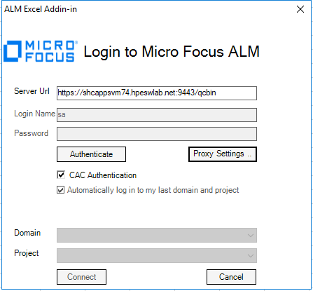
[BV Excel] BV Excel Add-in supports CAC and SiteMinder
Select CAC Authentication
Click Authenticate
Select certificate in popup

Slide 51
ALM 15 System Requirements Change

Slide 52
System Requirements
Added
MS SQL 2017
Oracle 19c
Windows Server 2019 for both server and client
Windows 10 1809
Removed
Windows Server 2008 R2

Slide 53
www.microfocus.com

